Slide 1

IMDB Score Prediction using EDA

Slide 2
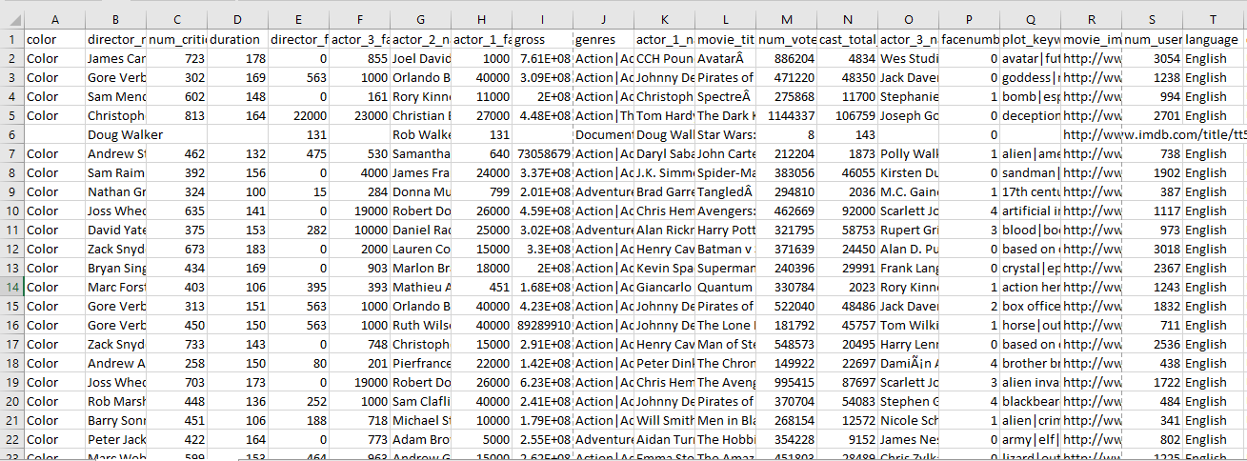
Dataset Description
The IMBD Movie Dataset that we were provided with included the following variables:
Director Name
Duration (Movie)
Genres
Plot Keywords
Language
Using these variables, the data set can help us determine many things, such as:
What is the average IMBD Score? Which movies performed higher than average? Which performed lower?
What is the average movie budget?
How many movies has "X" Director created? For what genre? What was the average budget?
How many movies were created in French in 2015?
Country
Budget
Title Year
Actors
IMBD Score

Slide 3
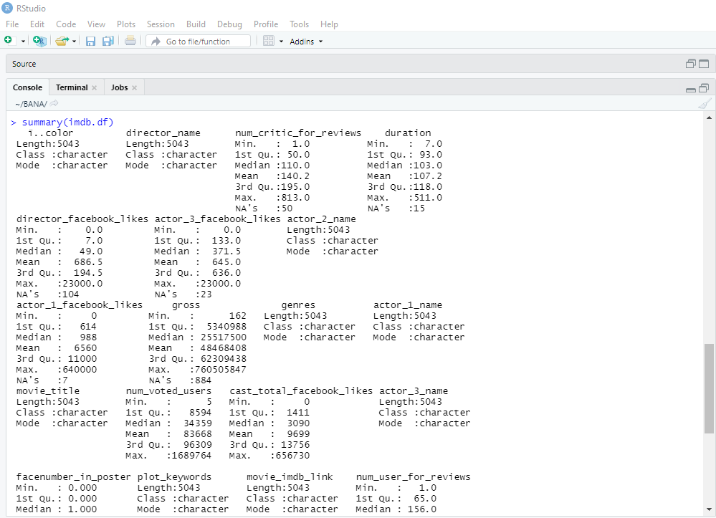
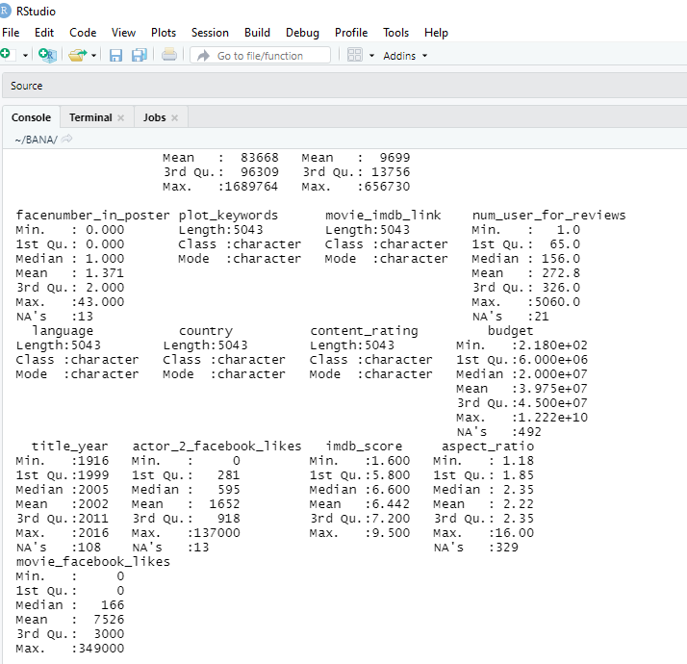
Summary Statistics
The Summary Statistics table provided us with a "summary" of each of the numerical variables provided in the dataset (I.e. Director Facebook Likes)
Each numerical summary includes the Minimum, 1st quartile, median, mean, 3rd quartile, maximum, and any N/A's
One interesting takeaway from the "Duration" summary is that the shortest movie included in this catalog was 7 minutes long, while the longest was 511 minutes long

Slide 4
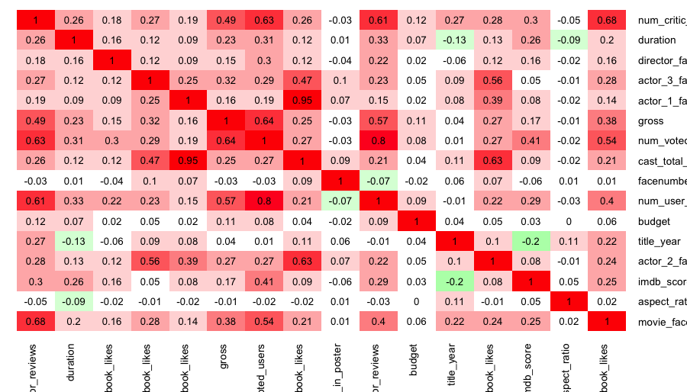
Correlation Matrix
Our Heatmap provided us with the correlation between each variable from our dataset.
Example: Near the top right corner, there is a green box that says -.09. This means that there is a positive correlation between the duration of the movie and the aspect ratio.

Slide 5
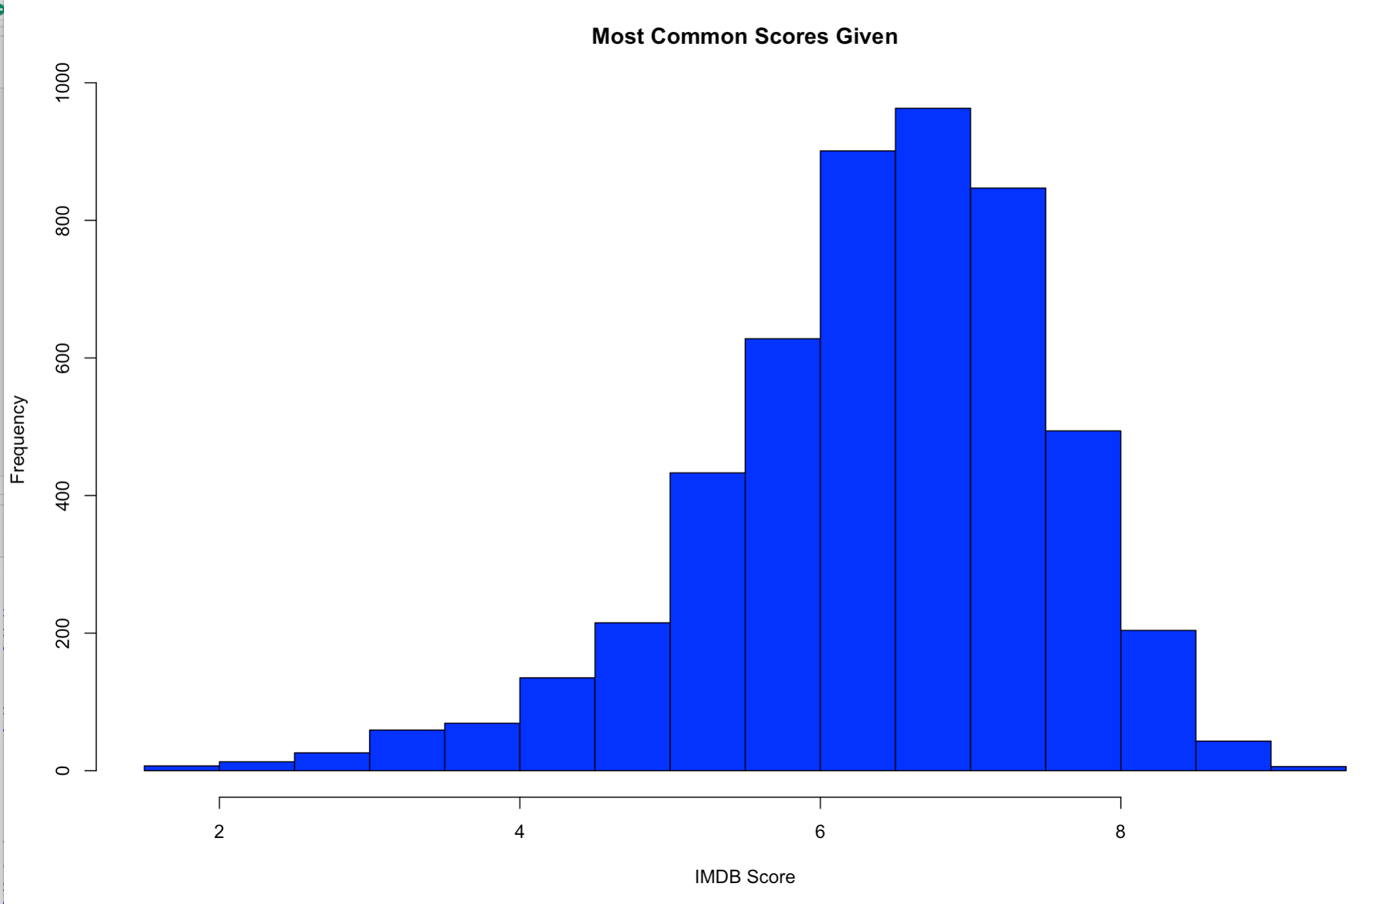
Histogram
This Histogram shows the most common IMDB scores given out.
There is a sizeable spike from the 6-8 range showing that it is most common for IMDB to give that score.
It also shows that it is very uncommon to have a score below 4 or above 8.

Slide 6
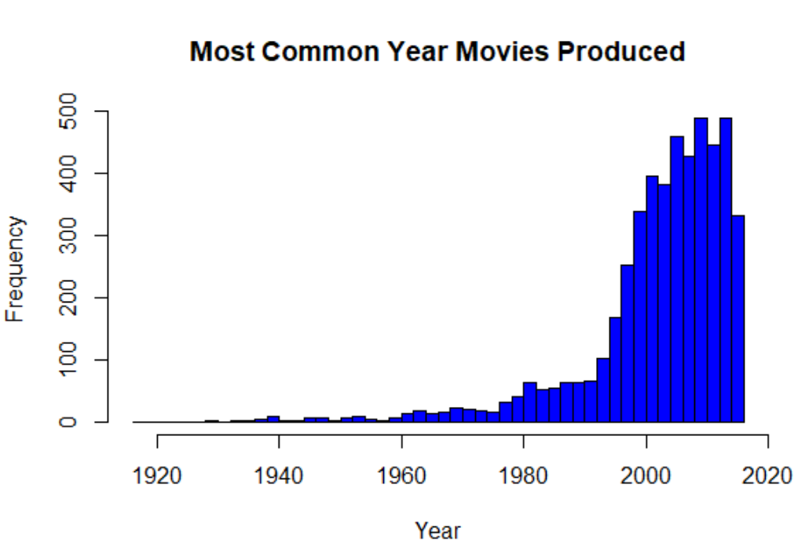
Histogram
This Histogram shows the total number of movies in the dataset produced by the year.
As you can see, the dataset has a significant more amount of movies made starting at the turn of the century due to the development of technology.

Slide 7
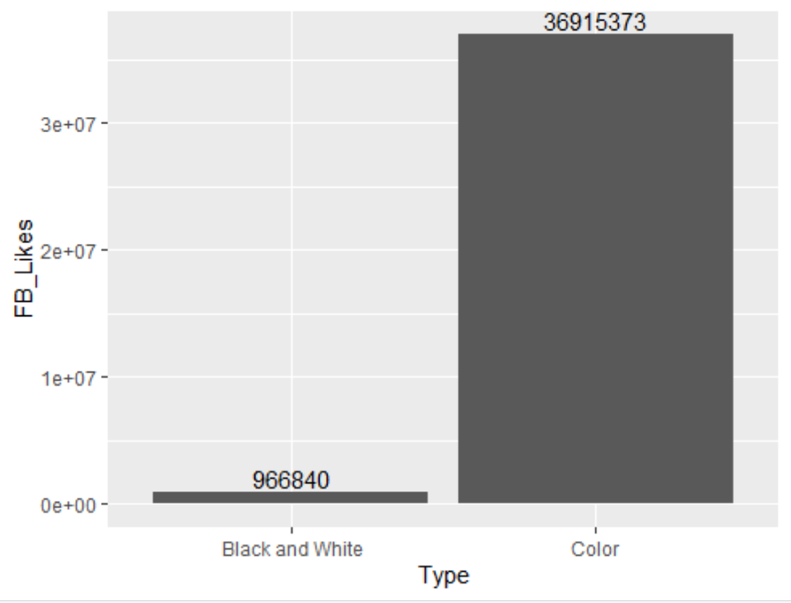
Bar Chart
This Bar Chart compares the "Type" of movie – in this case, B&W vs. Color – to the number of Facebook likes that the movie has. It is clear, based on the chart, that Color movies get significantly more FB likes than B&W.
This most likely comes with the fact that color movies were more likely to be released when facebook was more popular than when black and white movies were released.

Slide 8
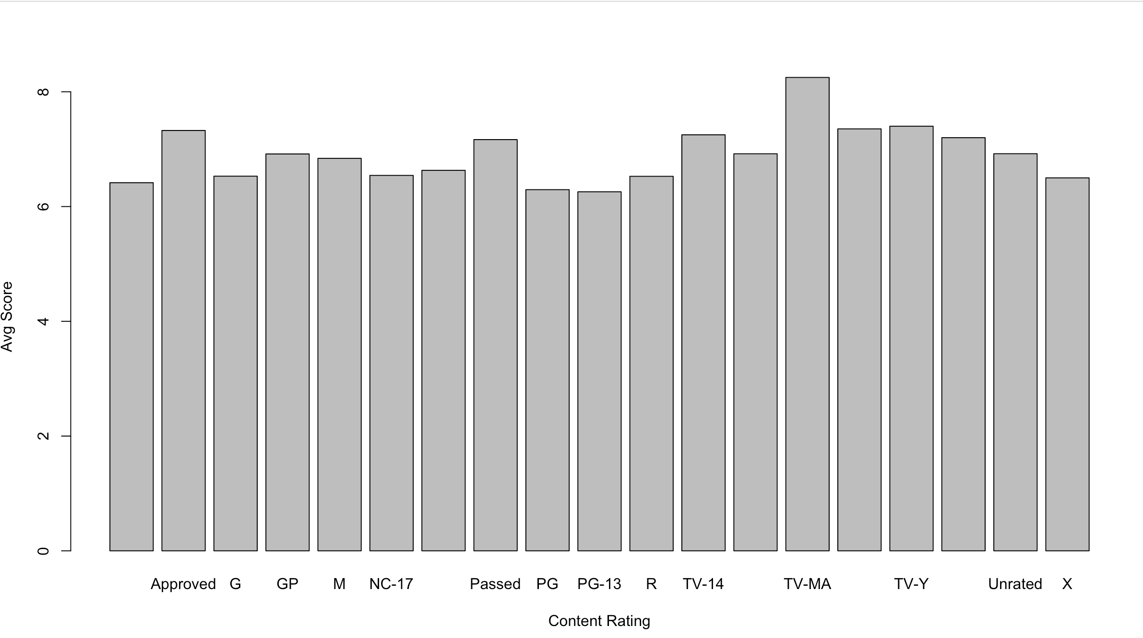
Bar Chart
This Bar Chart shows the average IMDB score by content rating.
Here we see that TV-MA has the highest average score, with PG and PG-13 having the lowest.
There is not an obvious correlation tied to the average score as the content rating changes towards the more mature side (right of the graph)

Slide 9
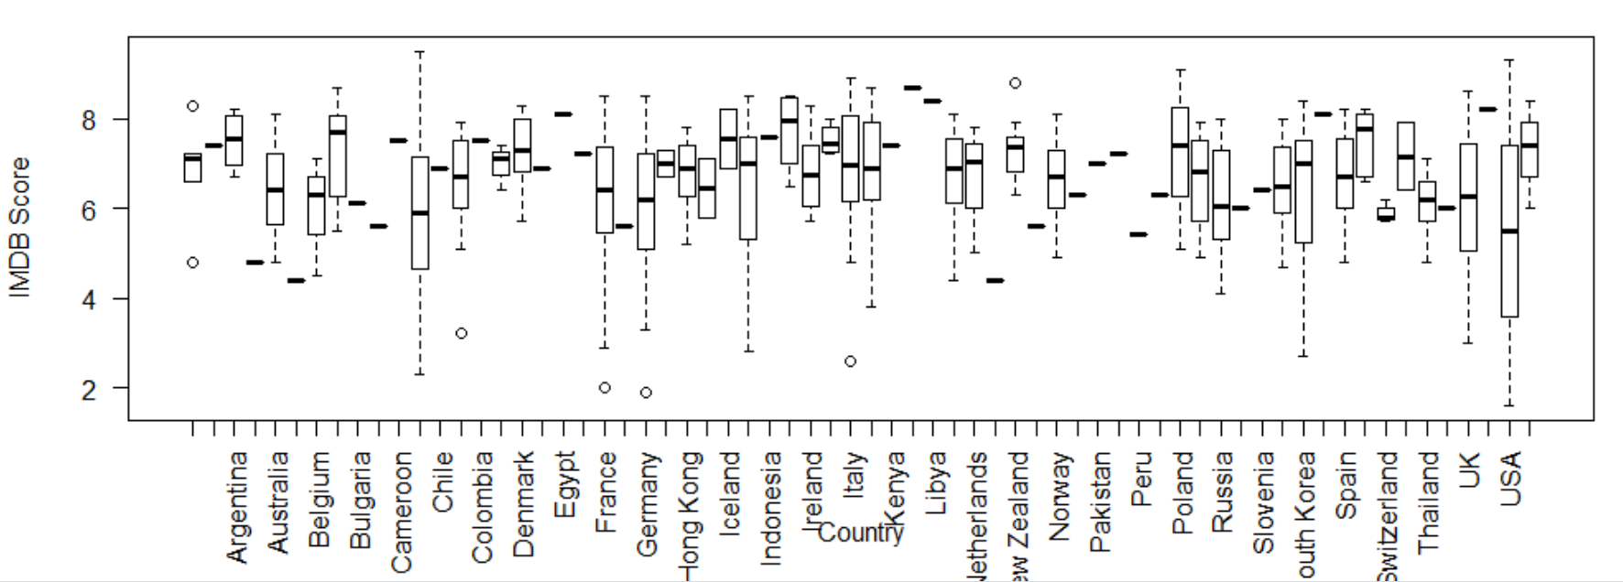
Box Plot
This Box Plot demonstrates the IMDB score for the movies in each country.
This plot shows that the United States has a lower average score but a wider range of scores than most countries.
Comparable to the UK in range of scores they have a slightly higher mean with a lower max score overall.
The country that is not listed on the X axis with the highest max score is Canada. It is interesting to note that even with that high of a max score and a relatively large range, the mean is still comparable to that of the USA.

Slide 10
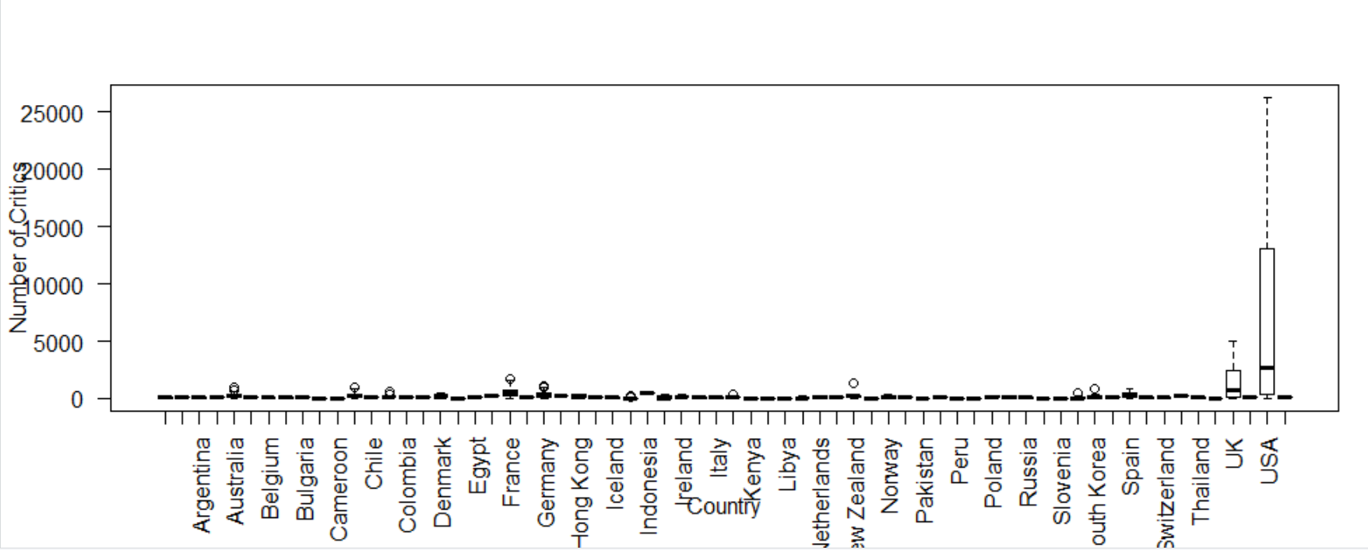
Box Plot
This Box Plot demonstrates the total number of critics for movies produced in each country
English-content movies (UK & USA) gain wide range number of critics than movies spoken in another language with notably higher average number of critics

Slide 11
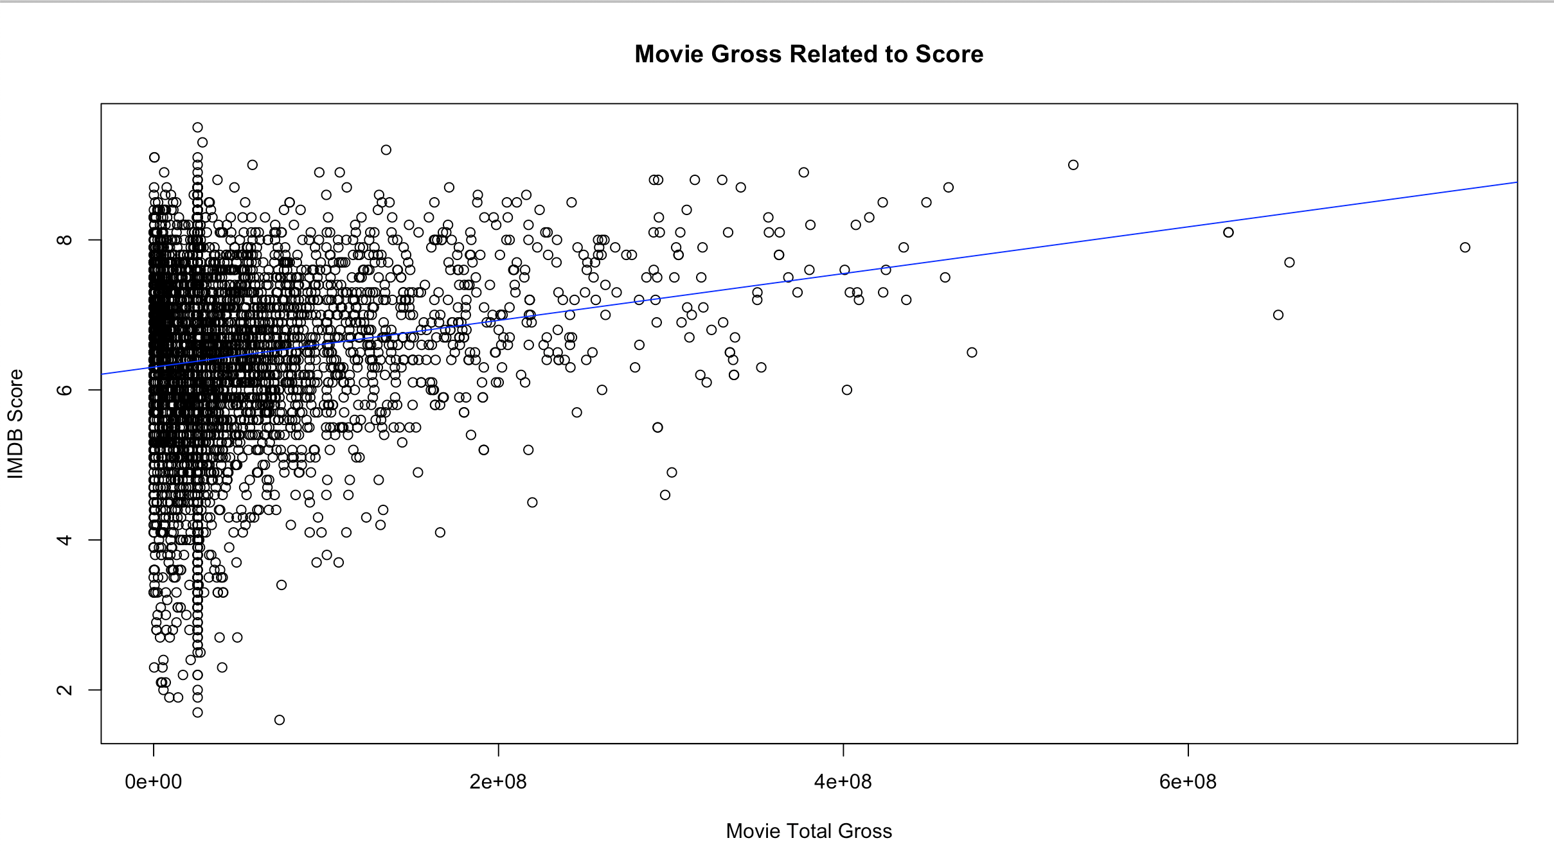
Scatter Plot
Scatter plot that illustrates the amount of money each movie made relative to the IMDB score they received (out of 10)
There is a positive correlation between the movies' Total Gross profit and IMBD score, indicated by our trend line.

Slide 12
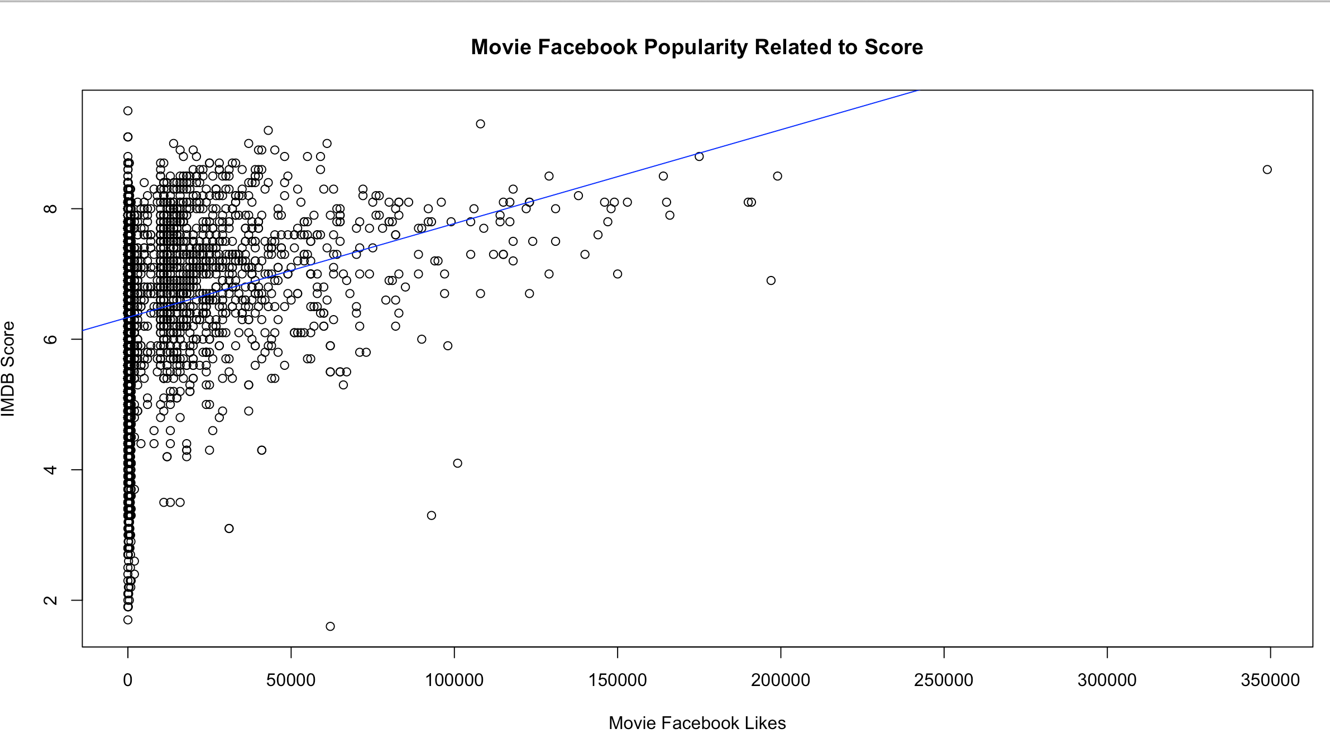
Scatter Plot
Scatter plot that illustrates how popular a movie is (Facebook likes) relative to the IMDB score that it received.
There is a positive correlation between the number of Facebook Likes a movie receives and its IMBD score, indicated by our trend line.

Slide 13
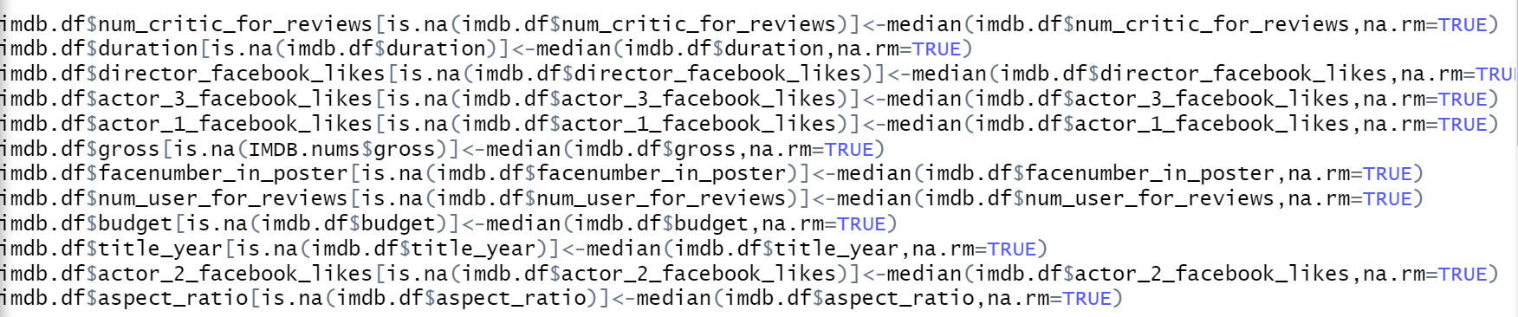
Handling Missing Data
The code below goes to each numerical variable with missing data (N/A value) and substitutes that missing data point with the median value of the variable.

Slide 14
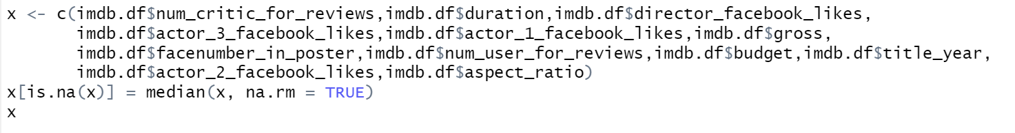
Handling Missing Data
The code below is a shorter way to substitute missing value with median value

Slide 15
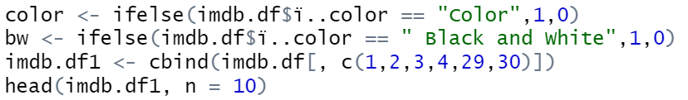
Binary Dummy Variables - Code
We choose the movie type (Color and Black & White) as the predictor for the dummy variables. Below shown that 1 & 0 are subsequently dummy variables for "color" & "black & white"

Slide 16
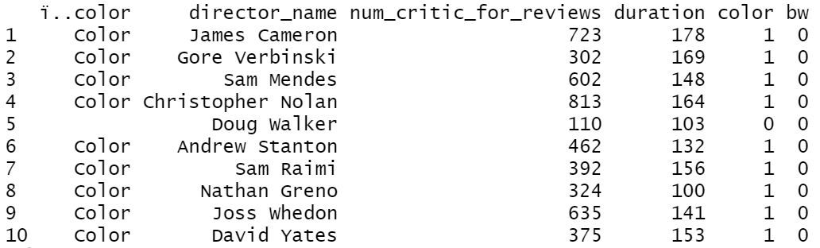
Binary Dummy Variables - Result
We choose the movie type (Color and Black & White) as the predictor for the dummy variables. Below shown that 1 & 0 are subsequently dummy variables for "color" & "black & white"

Slide 17
Conclusion
Using our data analysis, we can conclude that:
As time has gone on, movies have been produced more frequently than in the past.
The most common IMDB score given was a 7.
A higher score will result in increased Facebook popularity.
The higher a IMDB score it, the more money the movie will produce. This also goes vice versa, meaning that the higher the gross profit a movie has, generally the higher the IMDB score will be.
Due to the high amount of movies produced throughout the 21st century it is easy to understand the platform movies have had the ability to establish on Facebook.
English-content movies (UK & USA) have a higher average number of critics than movies in foreign languages do.

